Slide 1
Car Following Project
Josh Baird, Evan Haskell, Justin Kur, Charlie Wingate
Notes:
Claimed by everyone

Slide 2
Background
Our group continued an earlier effort from another project team in the development of an automated leader/follower vehicle system.
The system is composed of the following:
A desktop application to allow pilots to operate the vehicles
Two or more camera equipped programmable smart vehicles
As a research-focused project, we experimented with several driving algorithms
Notes:
Evan
We are the car following project. Our group is continuing an earlier effort from another project team to develop an automated leader/follower vehicle system. One vehicle, manually piloted, is the leader and one or more other vehicles are to automatically follow behind a leader, using a front-facing camera. In our case, our hardware is 2 Sunfounder PiCars, powered by a Rasberry Pi. Each includes a camera on the front which can pan up and down and turn left and right. We also include something called an Aruco tag on the back of the picars which can be seen by the follower and used to determine the orientation and position of the leader.
The goal of our project was to ultimately increase the functionality, improve the performance, and increase the ease of use of the leader/follower vehicle system.

Slide 3
Long Term Challenges
As a research project, we faced different problems than a traditional application.
We only have two cars, which function primarily as a pair.
Motion blur from the camera results in the tag being impossible to detect a large amount of the time.
At times we experienced hardware issues.
Notes:
Charlie
Because we have only two cars which primarily function as a pair, it is difficult to properly balance the workload.
Because the tag is our only way of detecting the lead vehicle, this creates problems for our follower models.
At some points nuts had to be tightened to prevent the cars from falling apart.
There were two separate servo motor failures, which required replacement.
The batteries and chargers from the previous team were insufficient in various ways.

Slide 4
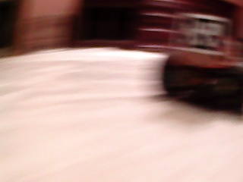
Initial Follower Algorithm
Detects Aruco markers using OpenCV and computes throttle and direction
Can only move when the tag is visible
Cannot adapt to a new environment
Cannot be generalized
Less interesting from a research perspective
Notes:
Evan
The initial follower algorithm detects Aruco markers using opencv. The throttle and direction is a simple calculation from position and size of the marker in each frame relative to an initial calibration frame.
Due to motion blur it is often not detectable. This creates jerky movement.

Slide 5
Enhancements to Initial System
Improved video streaming by saving images to disk
Added streaming of the car’s actions to the client
Improved log export
Upgraded to python 3
Notes:
Josh
There was initially support for streaming the camera feed to the client, but it did not save the video. We implemented saving of images to disk so that we could collect data to train our models.
To save training data, we also needed to implement streaming of the car’s actions to the client.
We also improved the log export so we could save the inputs given by the client and potentially replay them at a later time.
The initial server codebase was using python 2, but we wanted to update this in order to use more modern libraries.
We were able to update all required dependencies to python 3.5 after initially attempting to use python 3.6.
This included creating our own fork of the SunFounder codebase.

Slide 6
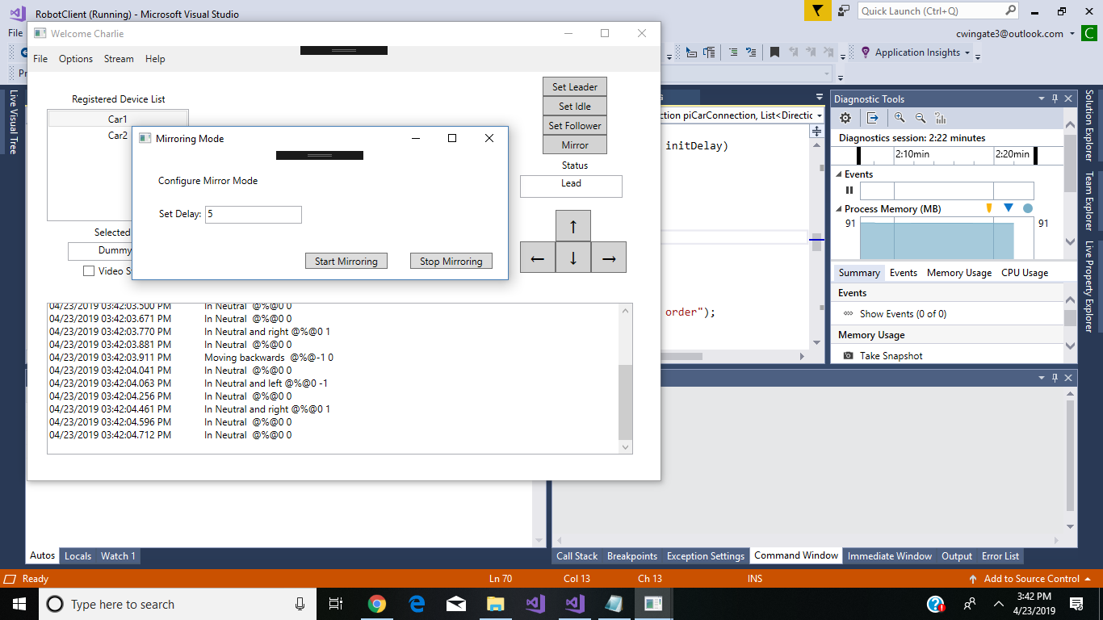
Replay/Mirror Mode
Our first idea for collecting training data was a mirroring mode
This had a number of logistical problems:
Choosing an appropriate delay was difficult
Differences in car calibrations led to divergent outcomes.
Notes:
Charlie
Mirroring mode: the leader car would be given remote commands and the follower would be given the same commands on a delay.

Slide 7
First Supervised Learning Attempt
Supervised follower with Convolutional Neural Network control:
Convolutional NNs are exceptional in computer vision
Even attempts with small neural networks failed on our hardware
A supervised approach is less flexible than reinforcement learning
Notes:
Justin
Segfaults
Our collected data would still be of use for other models.
RL is more flexible than this initial approach.

Slide 8
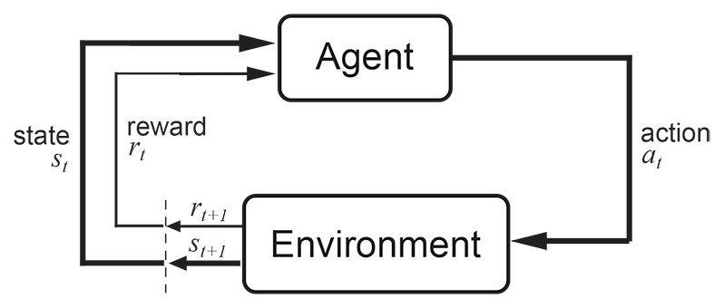
Reinforcement Learning
Notes:
Justin

Slide 9
First Q-Learning Follower
Q-Learning with tabular lookup
Had limited feature dimensionality
Mostly learned to stay still except in a few cases.
Notes:
Josh
Tabular Q-learning requires a finite state and action space
The states were combinations of good/near/far and straight/left/right, and the actions were similarly made up of discretizations of throttle and direction.
The representation of the tag was limited at this time.

Slide 10
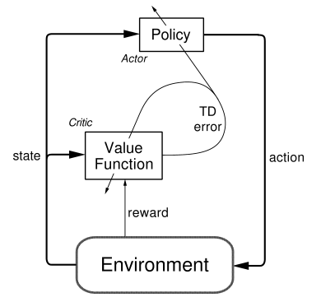
Actor-Critic Follower
Our state and action spaces are naturally continuous, which the actor critic can support
The model displays “oscillating” behavior, which is not desirable.
Notes:
Justin
We wanted to try a more complex model that would be able to incorporate this.
The actor-critic model learns distributions for the actions, and then samples from that distribution. As a result, it oscillates

Slide 11
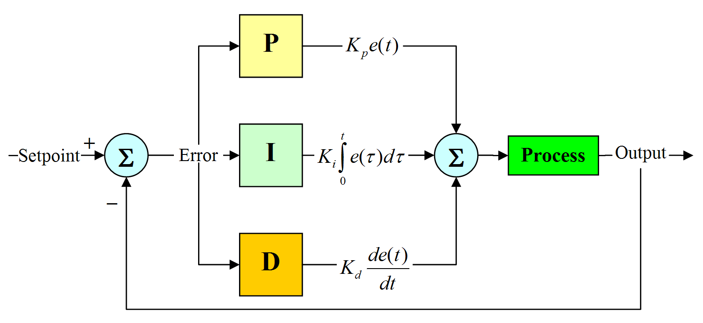
PID Follower
Experimented with using PID for real-time control
Our PID-based follower tried to optimize the continuous distance variable, which resulted in oscillating behavior.
Notes:
Justin
The idea of using PID for robot control is far from new, and its popularity led us to experiment with using it for real time control.
Camera blur and latency problems.

Slide 12
Color Homogeneity
With Reinforcement Learning, it’s sensible to make crashes a negative reward signal
A simple way of detecting this is seeing too little color variation
This did not work well in practice
Considering its performance overhead, we scrapped this feature
Notes:
Josh

Slide 13
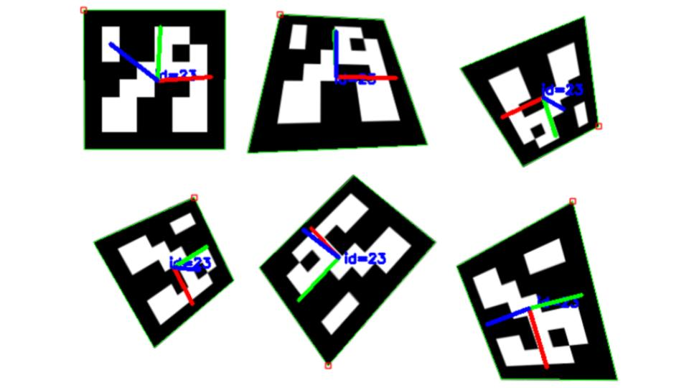
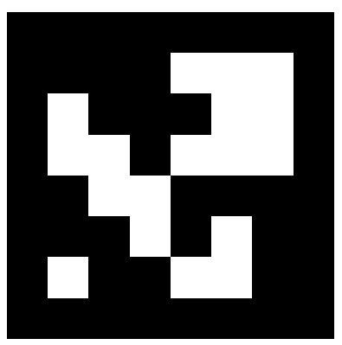
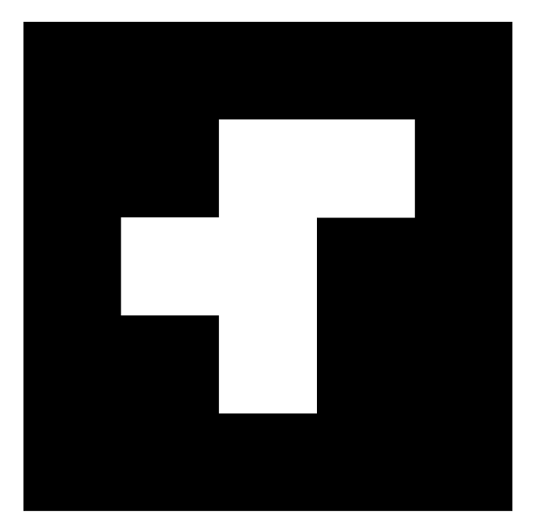
Pose Estimation
Using OpenCV, we were able to obtain three dimensional rotation and translation vectors in proper scale to the size of the tag.
We also reduced the complexity and increased the physical size of the tag
Notes:
Josh
Until this point, all tag detection was rudimentary and was only based on the four corners of the detected square.
Opencv is capable of doing pose estimation using the aruco tags,
This was a large improvement, particularly for our reward function and states.
Reduced size is easier to detect.

Slide 14
Second Q-Learning Follower
State and action spaces were quantized by configurable thresholds.
Failed to turn effectively because of the long-term foresight involved
Notes:
Justin
Using the newly available pose estimation and seeing the drawbacks of the actor critic model, we returned to a Q-learning based approach.

Slide 15
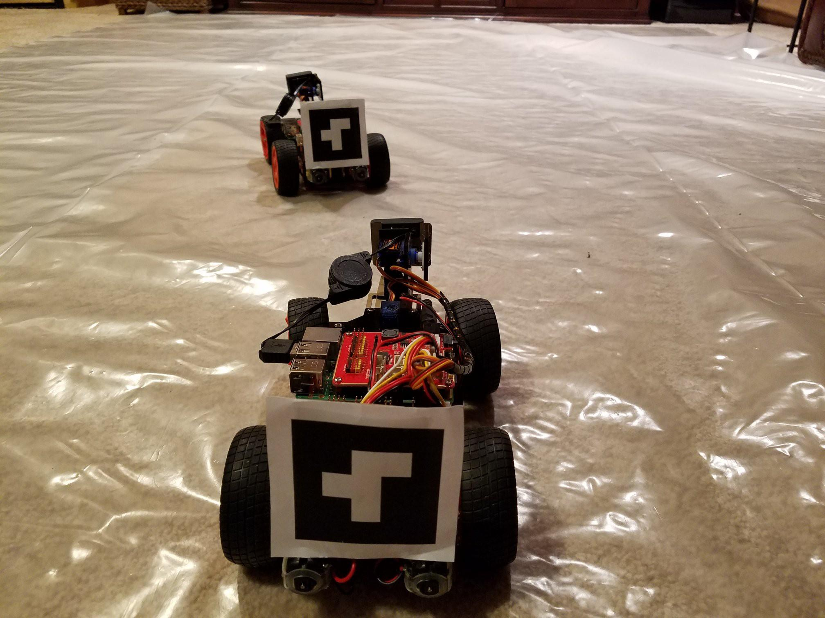
Current Follower
Combines our RL control with a rule-based turning controller.
For practical purposes we used our tag features to create a reasonable turn and realignment signal and procedure.
Notes:
Justin

Slide 16
Future Work
Hierarchical reinforcement learning to train turning control
Better methods for training data collection
Notes:
Justin

Slide 17
Summary
This project was a learning experience in several different regards, including:
Different areas of machine learning
CNN
Too big and slow for a pi
Q-Learning
Difficulty of representing state and action space
Actor-Critic
Insufficient data to train this complex model
The importance of documentation for long-term projects
Various technologies:
gRPC protocol
Python and C#
Git
Notes:
Charlie
Make it professional
Use graphics (not lengthy bullet list)
Show authority + ownership (body language)
Continuous Story: not discrete elements
20 mins + (their Q/A. Questions => Good)
Software engineering elements
- Future work?
- Negative reward for oscillating?
- Mention assumptions about leader movement / desired behavior
- More pictures ***
Algorithm Pictures
- Don’t read slides
- Talk through demo
- Hard bound on image size to stop oscillation (don’t reverse)
Steven Bialecki
sbialecki@kevadiya.com

